Slide 1

Agent Activity Chart
1/30/2023 11:21 PM
Print User : automation
Page 1 of 3

Slide 2
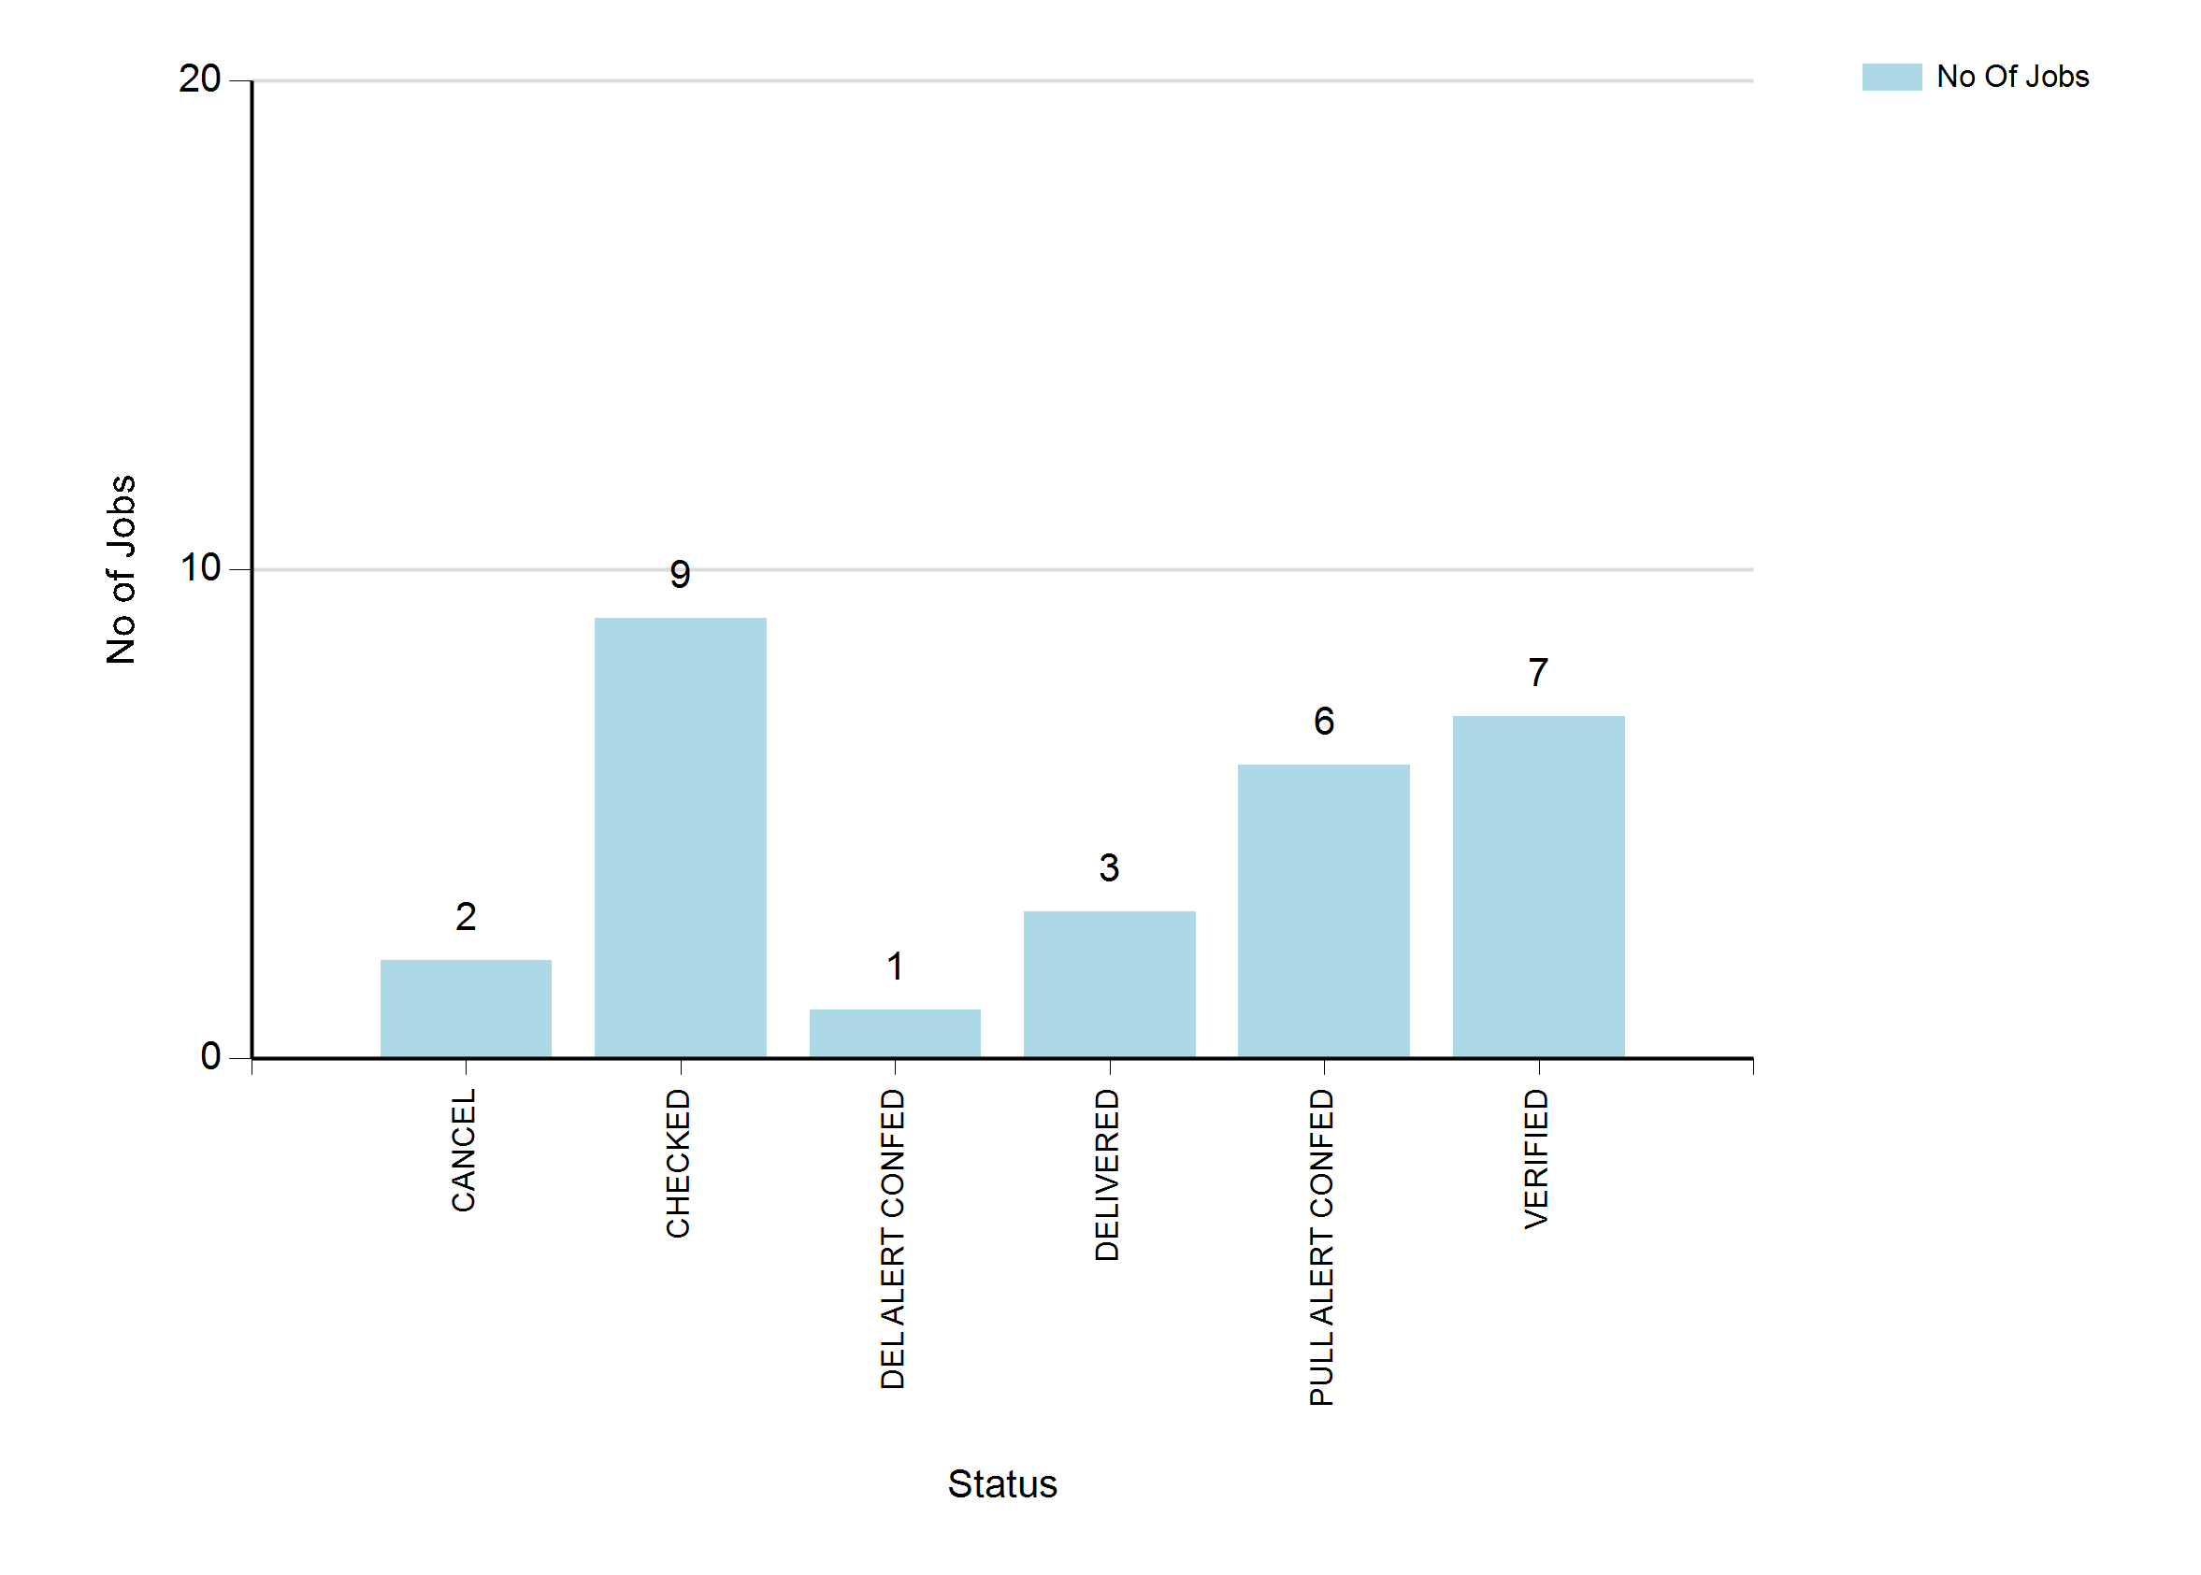
1/30/2023 11:21 PM
Print User : automation
Page 2 of 3

Slide 3
1/30/2023 11:21 PM
Print User : automation
Page 3 of 3

